Slide 1

Engineering Economics| MEE2001 | 3 Credits | 3 0 0 3
Lecture 6
Cost Analysis

Slide 2
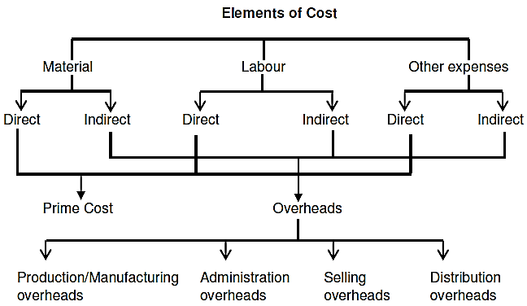
Concepts of Cost
Lecture 6
Cost is the amount of resource given up in exchange for some goods or services. The resources given up are money or money’s equivalent expressed in monetary units.
Direct Costs: The direct costs are those which can be easily traceable to a product or costing unit or cost
center or some specific activity, e.g. cost of wood for making furniture. It is also called traceable cost.
Indirect Costs: The indirect costs are difficult to trace to a single product. They are common to several products, e.g. salary of a factory manager. It is also called common costs.

Slide 3
Classification of Cost
Lecture 6
Manufacturing cost , non-manufacturing cost
Period cost (Expenses, Depreciation), product cost
Fixed cost: Remains constant & doesn’t depends upon the units produced
Variable cost: It varies with quantity produced
Fixed cost/unit: It is a variable value
Variable cost/unit: It is a fixed value
Mixed cost: Both component of F & V
Sunk cost
(the cost which has been incurred in past and can’t be recovered. These costs don’t affect the decision making in future.)

Slide 4
ELEMENTS OF COSTS
Lecture 6
Manufacturing Cost
Direct material cost
(input material cost incurred directly in manufacturing of goods/services)
Direct labor cost
(input labor cost incurred in manufacturing of goods/services)
Manufacturing overheads
(other input cost incurred in manufacturing of goods/services such as electricity cost, depreciation cost of machines etc.)
Non-manufacturing Cost
Cost associated with marketing and advertising
(input cost incurred in promotion of manufactured goods/services)
Administrative expenses
(input cost incurred in salaries of different levels, meetings etc.)
Non-manufacturing overheads
(other input cost incurred in non-manufactured works such as electricity, depreciation cost of other assets etc.)

Slide 5
COMPLETE THE FOLLOWING SCHEDULE:

Slide 7
Break-even analysis
Lecture 6
The categorization of costs into “variable” and “fixed” elements and their relationship with sales and profits has been developed as “break-even analysis”.
This break-even analysis is also known as Cost–volume–profit (CVP) analysis.
The study of the effects on future profit of changes in fixed cost, variable cost, sales price, quantity and mix.
In break even analysis or CVP analysis, an activity level is determined at which all relevant cost are recovered and there is a situation of no profit or no loss. This activity level is called break-even point.
The break-even point in any business is that point at which the volume of sales or revenues exactly equals total expenses or the point at which there is neither a profit nor loss under varying levels of activity.
The break-even point tells the manager what level of output or activity is required before the firm can make a profit; reflects the relationship between costs, volume and profits. In another words breakeven point is the level of sales or production at which the total costs and total revenue of a business are equal.

Slide 8
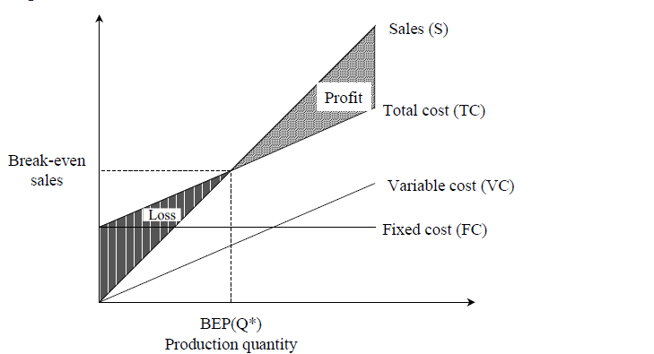
BREAK-EVEN ANALYSIS
Lecture 5
This point is also called the no-loss or no-gain
situation. For any production quantity which is less than the break-even quantity, the total cost is more than the total revenue. Hence, the firm will be making loss.
For any production quantity which is more than the break-even quantity, the total revenue will be more than the total cost. Hence, the firm will be making profit.

Slide 9
Break-even analysis
Lecture 6
C = Total Cost (represented by slope of line AC)
F = Fixed cost (represented by line OA and AF)
V = Variable cost per unit (represented by slope of line OC)
S = Selling cost per unit (represented by slope of line OD)
I = Income (also representing by slope of line OD)
If , N = no. of units produced during the year
Then, I = S*N
Total cost = Fixed cost + Variable cost
TC = F + V*N
Profit (P) = Income (I) ̶ Total cost (TC)
P = I ̶ ( F + V*N)
P = S* N ̶ ( F + V*N) = ̶ F + (S ̶ V) N
At break-even point; Income (I) = Total cost (TC) (S ̶ V) = marginal contributions
I = S*N = F + V*N
N = F/(S ̶ V) = N* (Break-even quantity)
D
Cost or Income
C
C
A
F
O
N*
N
No. of units

Slide 10
Break-even analysis
Lecture 6
P = S* N ̶ ( F + V*N)
P = ̶ F + (S ̶ V) N
(S ̶ V) = marginal contributions
Effect of fixed cost
If F is decreased and V is remains constant
(S ̶ V) remains constant i.e. slop of line AB
remains constant.
This results into smaller value of N* i.e. break-even point
is reached early, with lesser no of products sold.
Contrarily, if F is increased, N* shift to the right i.e.
Break-even point gradually increased.
D
Profit
N*
B
F
O
N*
C
A
N*
Loss
E
No. of units

Slide 11
Break-even analysis
Lecture 6
D
Profit
B
Profit
N*
Profit
B
B
F
N*
N*
N*
O
A
A
A
N*
Loss
E
No. of units
No. of units
No. of units
When Fixed Cost Increases
When Fixed Cost Decreases

Slide 12
Break-even analysis
Lecture 6
P = S* N ̶ ( F + V*N)
P = ̶ F + (S ̶ V) N
Effect of variable cost
If variable cost per unit is changed, keeping fixed cost
Constant, (S ̶ V) = slope of line AB changes
If variable cost per unit is increased and fixed cost
is constant i.e. (S ̶ V) marginal contributions
decreases and so slop of line AB decreases and takes
line AC.
In this, it is seen that break-even point is shifted towards
right i.e., more no of units are to be produced & sold for
coming to position with no profit or loss.
Contrary to that, when V is decreased keeping F constant,
i.e. (S ̶ V) marginal contributions increases and so slop of line AB increases and takes
line AD. it is seen that break-even point is shifted towards left i.e. less no of units are to be produced & sold for coming to position with no profit or loss.
D
N*
B
Profit
C
N*
A
N*
Loss
No. of units

Slide 13
Break-even analysis: Numerical
Lecture 6
F = Fixed cost = Rs. 10,00,000
V = Variable cost per unit = Rs. 10
S = Selling cost per unit = Rs. 50
I = Income (also representing by slope of line OD)
(Break-even quantity)
N* = F/(S ̶ V) = 10,00,000/(50 ̶ 10)
= 25,000
If company has produced 30,000 units
Profit (P) = Income (I) ̶ Total cost (TC)
P = I ̶ ( F + V*N)
P = S* N ̶ ( F + V*N) = ̶ F + (S ̶ V) N
P = ̶ 10,00,000 + (50 ̶ 10) 30,000
P = 2,00,000 PROFIT
If company has produces & sold only 20,000 units
P = ̶ 10,00,000 + (50 ̶ 10) 20,000
P = ̶ 2,00,000 LOSS
D
Cost or Income
C
A
B
O
N*
N
No. of units

Slide 14
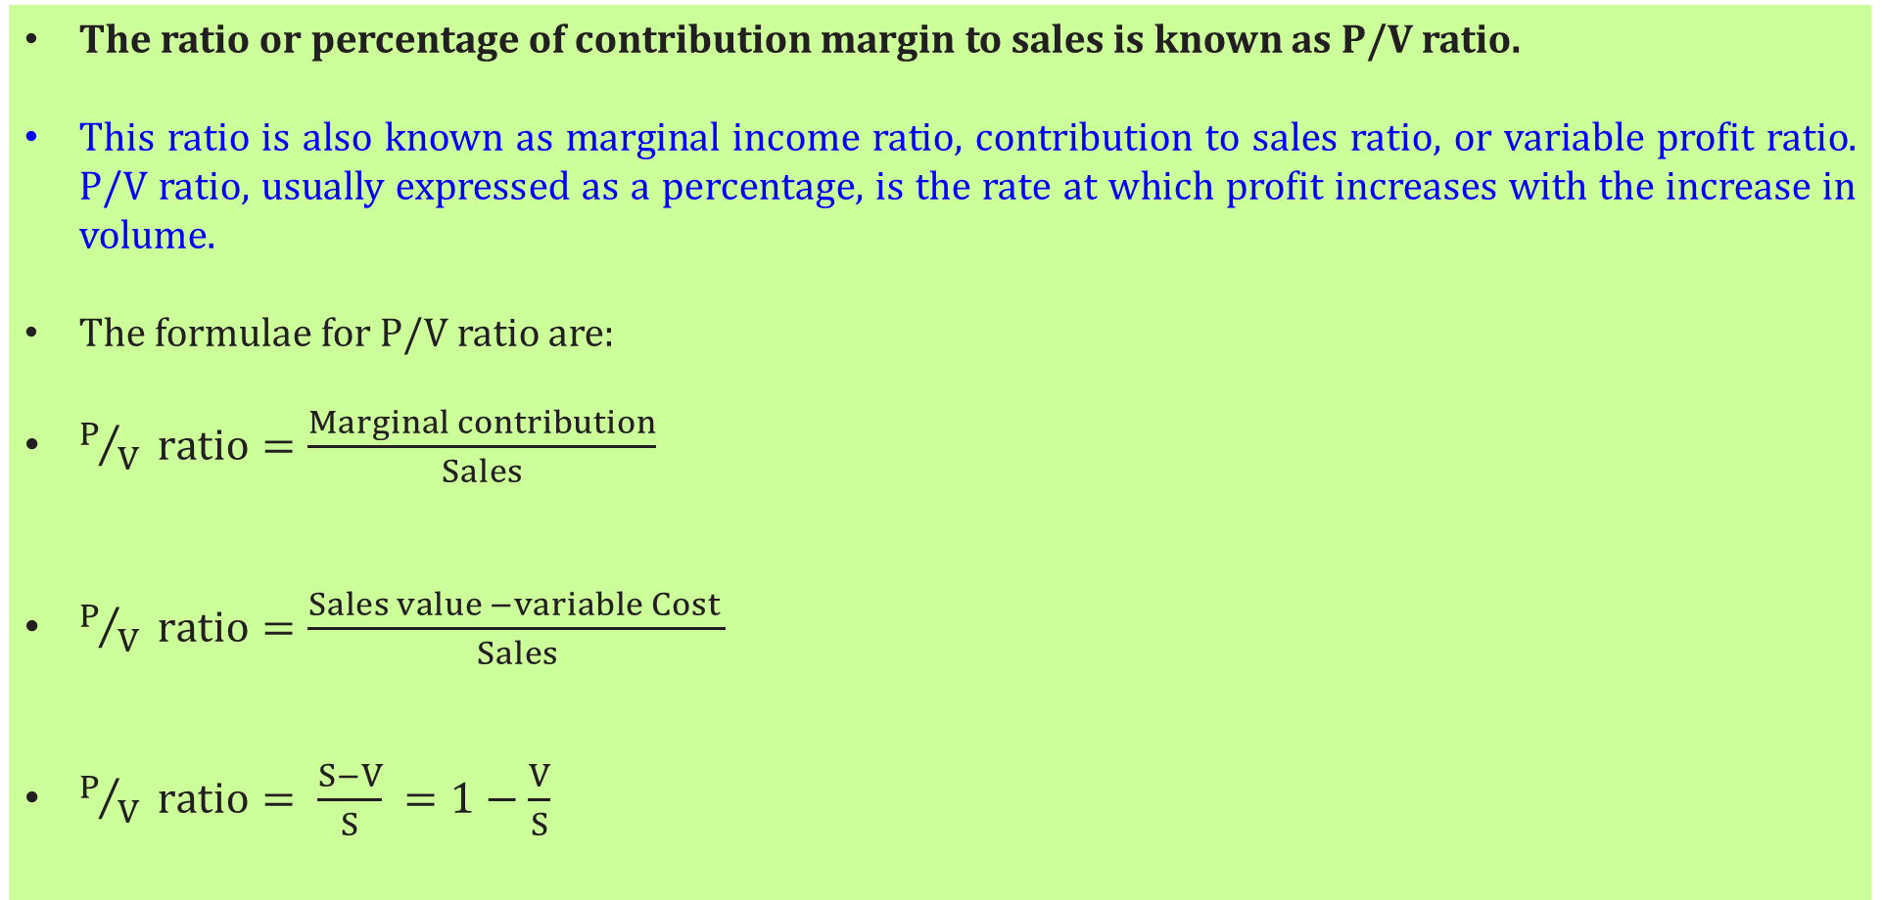
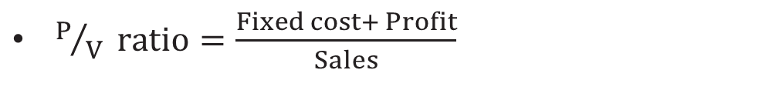
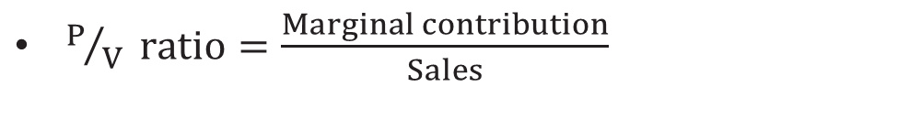
Profit-Volume Ratio
Lecture 6
The ratio or percentage of contribution margin to sales is known as P/V ratio.
This ratio is also known as marginal income ratio, contribution to sales ratio, or variable profit ratio. P/V ratio, usually expressed as a percentage, is the rate at which profit increases with the increase in volume.
The formulae for P/V ratio are:
$P/V ratio=\frac{Marginal contribution}{Sales}$
$P/V ratio=\frac{Sales value −variable Cost }{Sales}$
$P/V ratio= \frac{S−V}{S} =1−\frac{V}{S}$
$P/V ratio=\frac{Marginal contribution}{Sales}$
$P/V ratio=\frac{Fixed cost+ Profit}{Sales}$

Slide 15
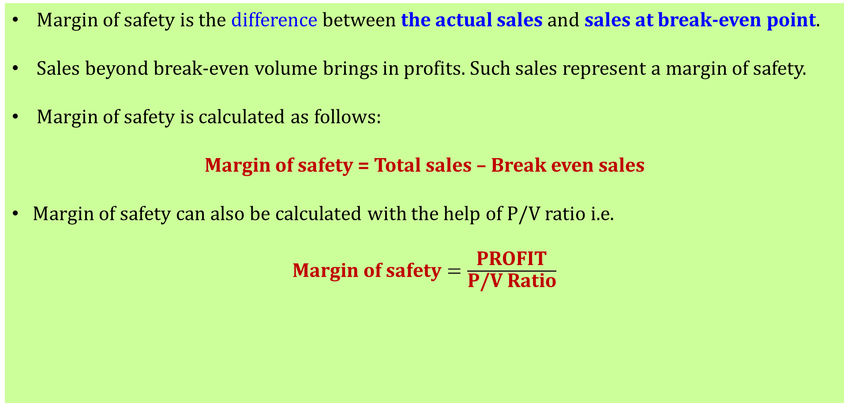
MARGIN OF SAFETY
Lecture 6
Margin of safety is the difference between the actual sales and sales at break-even point.
Sales beyond break-even volume brings in profits. Such sales represent a margin of safety.
Margin of safety is calculated as follows:
Margin of safety = Total sales – Break even sales
Margin of safety can also be calculated with the help of P/V ratio i.e.
$\text{Margin} \text{of} \text{safety}=\frac{\text{P}\text{ROFIT}}{\text{P}\text{/}\text{V} \text{Ratio}}$

Slide 16
MARGIN OF SAFETY
Lecture 6
It is important that:
there should be reasonable margin of safety, otherwise, a reduced level of activity may prove disastrous.
A low margin of safety usually indicates high fixed overheads so that profits are not made until there is a high level of activity to absorb fixed costs.
A high margin of safety shows that break-even point is much below the actual sales, so that even if there is a fall in sales, there will still be a point.
The margin of safety may be improved by taking the following steps:
(i) Lowering fixed costs.
(ii) Lowering variable costs so as to improve marginal contribution.
(iii) Increasing volume of sales, if there is unused capacity.
(iv) Increasing the selling price, if market conditions permit, and
(v) Changing the product mix as to improve contribution.

Slide 17
OTHER COSTS/REVENUES
Lecture 4
Marginal Cost
Marginal cost of a product is the cost of producing an additional unit of that product. Let the cost of producing 20 units of a product be Rs. 10,000, and the cost of producing 21 units of the same product be Rs. 10,045. Then the marginal cost of producing the 21st unit is Rs. approx. Rs. 45.
Marginal Revenue
Marginal revenue of a product is the incremental revenue of selling an additional unit of that product. Let, the revenue of selling 20 units of a product be Rs. 15,000 and the revenue of selling 21 units of the same product be Rs. 15,085. Then, the marginal revenue of selling the 21st unit is Rs. 85.
Sunk Cost
This is known as the past cost of an equipment/asset. Let us assume that an equipment has been purchased for Rs. 1,00,000 about three years back. If it is considered for replacement, then its present value is not Rs. 1,00,000. Instead, its present market value should be taken as the present value of the equipment for further analysis. So, the purchase value of the equipment in the past is known as its sunk cost. The sunk cost should not be considered for any analysis done from now onwards.

Slide 18
Opportunity Cost
Lecture 4
In practice, if an alternative (X) is selected from a set of competing alternatives (X,Y), then the corresponding investment in the selected alternative is not available for any other purpose. If the same money is invested in some other alternative (Y), it may fetch some return. Since the money is invested in the selected alternative (X), one has to forego the return from the other alternative (Y). The amount that is foregone by not investing in the other alternative (Y) is known as the opportunity cost of the selected alternative (X). So, the opportunity cost of an alternative is the return that will be foregone by not investing the same money in another alternative.
A person invested 50000 Rs in shares and earned a gain of Rs 7500 in a year.
If he invested in a fixed deposit, a bank would pay a return of 18%.
Then, the corresponding total return per year for the investment in the bank is Rs. 9,000.
This return is greater than the return from shares.
The foregone excess return of Rs. 1,500 by way of not investing in the bank is the opportunity cost of investing in shares.

Slide 19
Problem No: 1
Alpha Associates has the following details:
Fixed cost = Rs. 20,00,000
Variable cost per unit = Rs. 100
Selling price per unit = Rs. 200
Find
(a) The break-even sales quantity,
(b) The break-even sales
(c) If the actual production quantity is 60,000, find (i) contribution; and
(ii) margin of safety

Slide 20
Solution
Fixed cost (FC) = Rs. 20,00,000
Variable cost per unit (v) = Rs. 100
Selling price per unit (s) = Rs. 200
(a) Break-even quantity = FC/s-v
= 20,00,000/100 = 20,000 units
(b) Break-even sales = [FC/s-v] *s (Rs.)
= 20 00 000/100 * 200
= Rs. 40,00,000
(c) (i) Contribution = Sales – Variable cost
= s *Q – v *Q
= 200 *60,000 – 100 *60,000
= 1,20,00,000 – 60,00,000
= Rs. 60,00,000
(ii) Margin of safety
METHOD I
M.S. = Sales – Break-even sales
= 60,000 *200 – 40,00,000
= 1,20,00,000 – 40,00,000 = Rs. 80,00,000
METHOD II
M.S. = Profit/Contribution * Sales
Profit = Sales – (FC + v Q)
= 60,000 *200 – (20,00,000 + 100 * 60,000)
= 1,20,00,000 – 80,00,000 = Rs. 40,00,000
M.S. =40,00,000/60,00,000 *1,20,00,000
= Rs. 80,00,000
M.S. as a per cent of sales = (M.S./Sales)*100
= 80,00,000/ 1,20,00,000 *100
= 67%

Slide 21
PROFIT/VOLUME RATIO (P/V RATIO)
P/V ratio = Contribution/Sales
= Sales - Variable costs/ Sales
The relationship between BEP and P/V ratio is as follows:
BEP = Fixed cost/(P/V ratio)
The following formula helps us find the M.S. using the P/V ratio:
M.S. = Profit / (P/V ratio)

Slide 22
Problem No: 2
Consider the following data of a company
(i) Sales = Rs. 1,20,000
(ii) Fixed cost = Rs. 25,000
(iii) Variable cost = Rs. 45,000
Find the following:
(a) Contribution
(b) Profit
(c) BEP (Rs)
(d) M.S.

Slide 23
Solution
Given:
(i) Sales = Rs. 1,20,000
(ii) Fixed cost = Rs. 25,000
(iii) Variable cost = Rs. 45,000
(a) Contribution = Sales – Variable costs
= Rs. 1,20,000 – Rs. 45,000
= Rs. 75,000
(b) Profit = Contribution – Fixed cost
= Rs. 75,000 – Rs. 25,000
= Rs. 50,000
(c) BEP
P/V ratio = Contribution / Sales
= 75,000/1,20,000 = 62.50%
BEP (Rs) = Fixed cost/ (P/V ratio)
= 25000/62.50* 100
= Rs. 40,000
M.S. = Profit/P/V ratio
= 50 000/62 50 * 100
= Rs. 80,000

Slide 24
Problem No: 3
Consider the following data of a company
(i) Sales = Rs. 80,000
(ii) Fixed cost = Rs. 15,000
(iii) Variable cost = 35,000
Find the following:
(a) Contribution
(b) Profit
(c) BEP
(d) M.S.

Slide 25
Solution
Given:
(i) Sales = Rs. 80,000
(ii) Fixed cost = Rs. 15,000
(iii) Variable cost = Rs. 35,000
(a) Contribution = Sales – Variable costs
= Rs. 80,000 – Rs. 35,000
= Rs. 45,000
(b) Profit = Contribution – Fixed cost
= Rs. 45,000 – Rs. 15,000
= Rs. 30,000
(c) BEP
P/V ratio = Contribution / Sales
= 45,000/80,000
= 56.25%
BEP = Fixed cost/ (P/V ratio)
= 15000/56.25* 100
= Rs. 26,667
M.S. = Profit/(P/V ratio)
= 30 000/56.25 * 100
= Rs. 53,333.33

Slide 26
s = selling price per unit
v = variable cost per unit
FC = fixed cost per period
Q = volume of production
The total sales revenue (S) of the firm is given by the following formula:
S = s Q
The total cost of the firm for a given production volume is given as
TC = Total variable cost + Fixed cost = v Q + FC
Profit = Sales – (Fixed cost + Variable costs)
= s Q – (FC + v Q)
Break-even quantity = Fixed cost/Selling price/unit - Variable cost/unit
=FC/s-v (in units)
Break-even sales
= {Fixed cost/Selling price/unit - Variable cost/unit }* Selling price/unit
= {FC/s-v }*s (Rs)
Contribution = Sales – Variable costs
Contribution/unit = Selling price/unit – Variable cost/unit
M.S. = Actual sales – Break-even sales

